Slide 1
Load Test Execution
Day 3 - Chapter 1

Slide 2
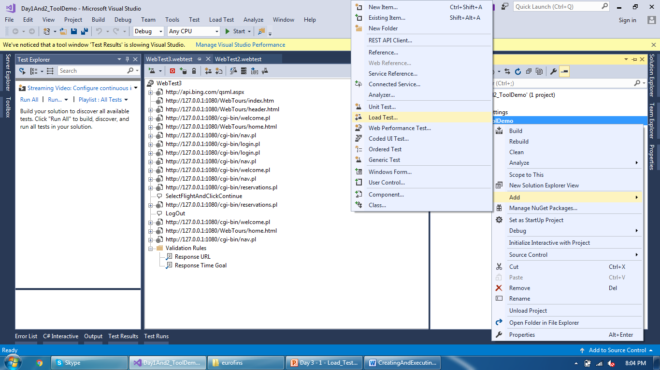
Load Test Execution
Right click on a project in Sol Explorer and add Load Test

Slide 3
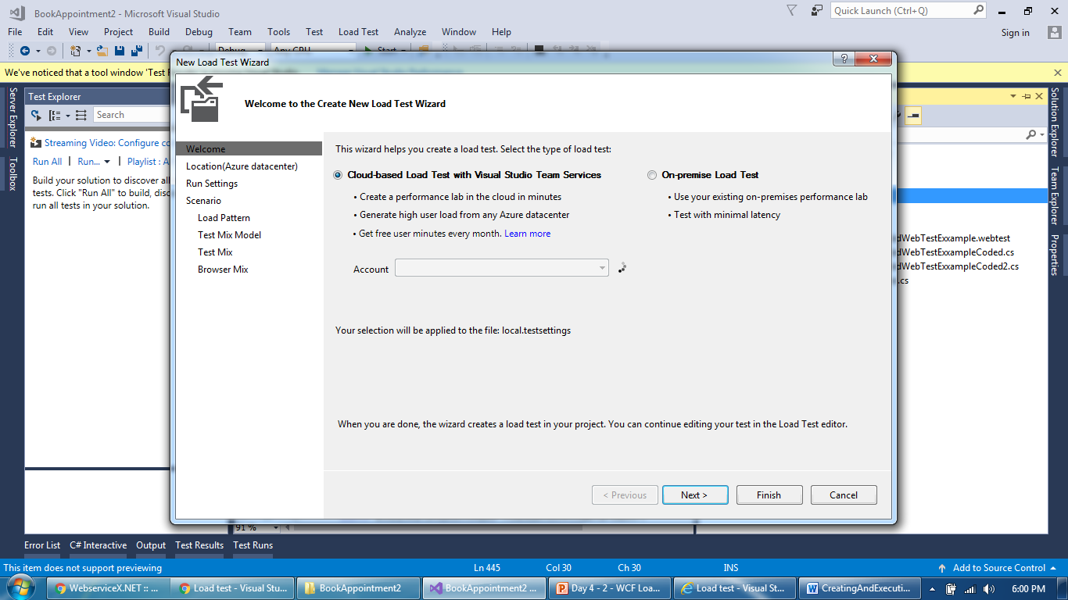
Load Test Execution
Two Options: Cloud Based Load Test or On-premise Local Test

Slide 4
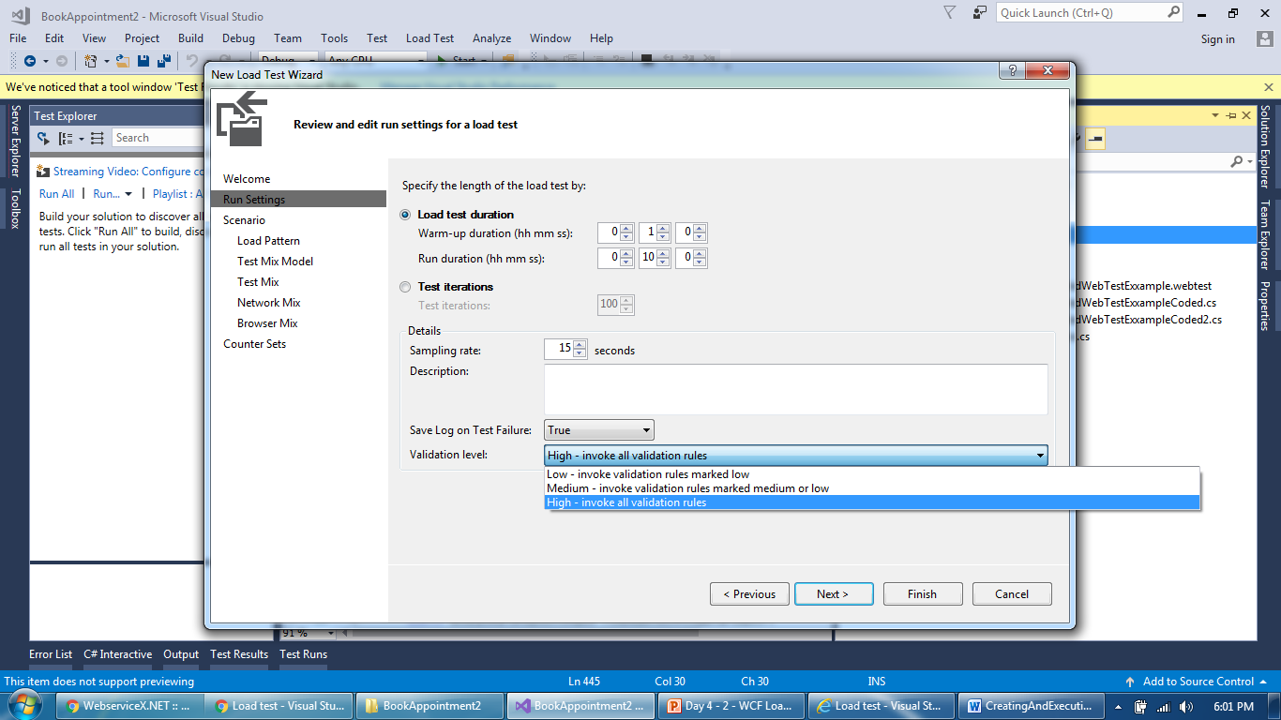
Load Test Execution
Provide Scenario Details like test duration, test iteration, Sampling rate (capture perf counters) and Validation level

Slide 5
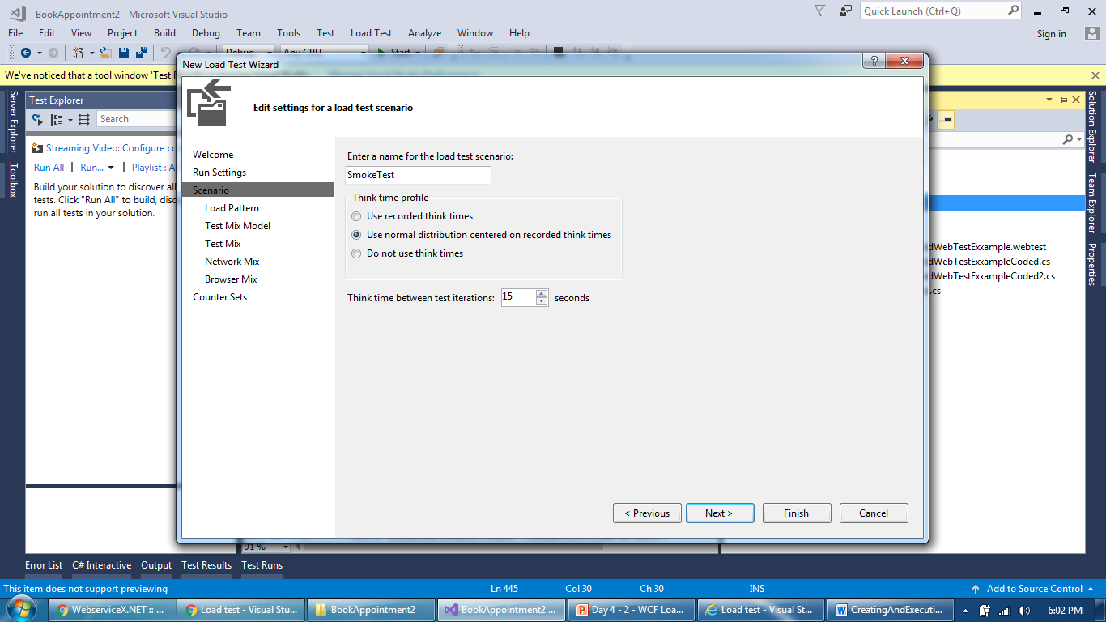
Load Test Execution
Identify response of a request where dynamic value exists

Slide 6
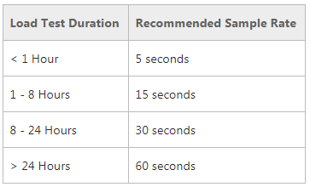
Load Test Execution
Sampling rate is a frequency of capturing performance counters during load test duration. Following table shows frequency value depending up on load test duration to avoid excess data which may create performance problems while plotting graphs
https://msdn.microsoft.com/en-us/library/ff423846.aspx

Slide 7
Load Test Execution
Think time in scripts can be overridden here and add pacing

Slide 8
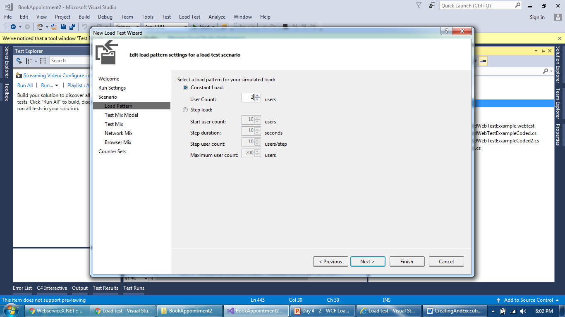
Load Test Execution
Design a scenario as per requirement (constant or step load)
e

Slide 9
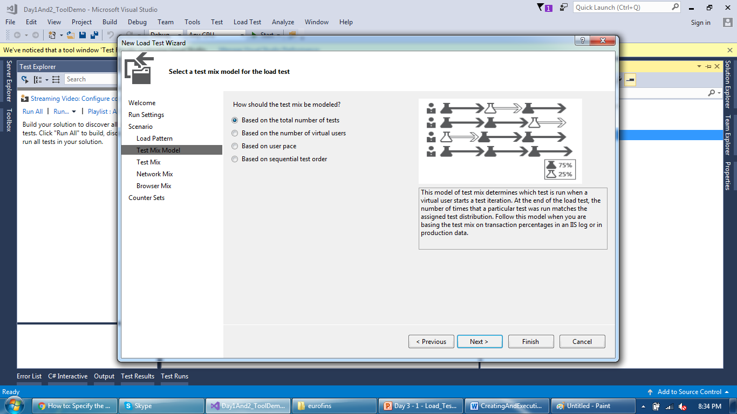
Load Test Execution
Mixed test with percentage of iterations for every script

Slide 10
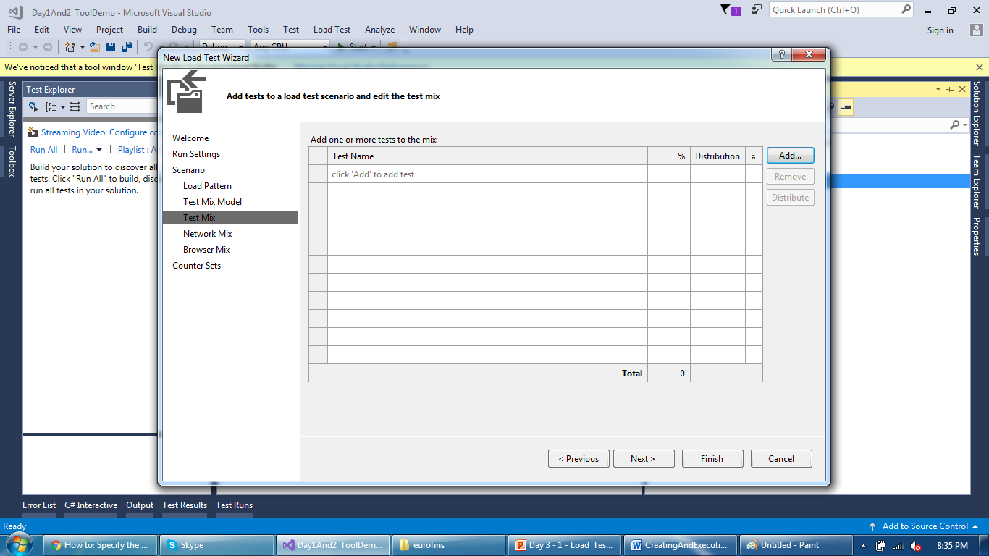
Load Test Execution
Add scripts to the test and provide percentage

Slide 11
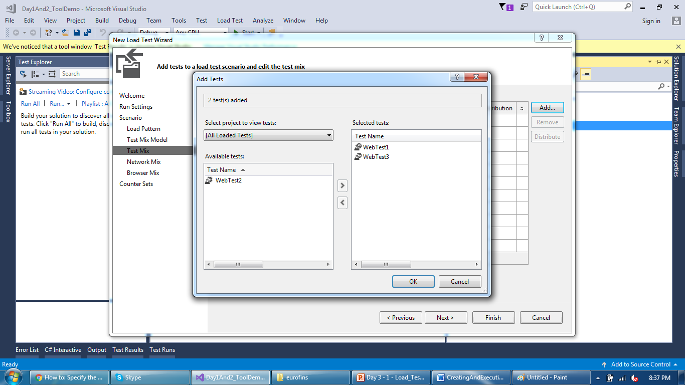
Load Test Execution
Add relevant scripts from your solution

Slide 12
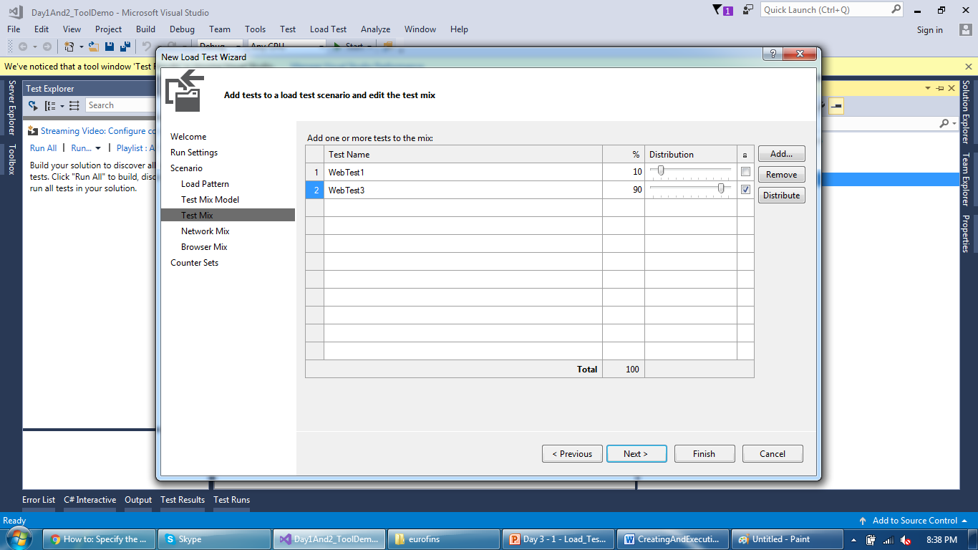
Load Test Execution
Provide percentage of total iterations across each script

Slide 13
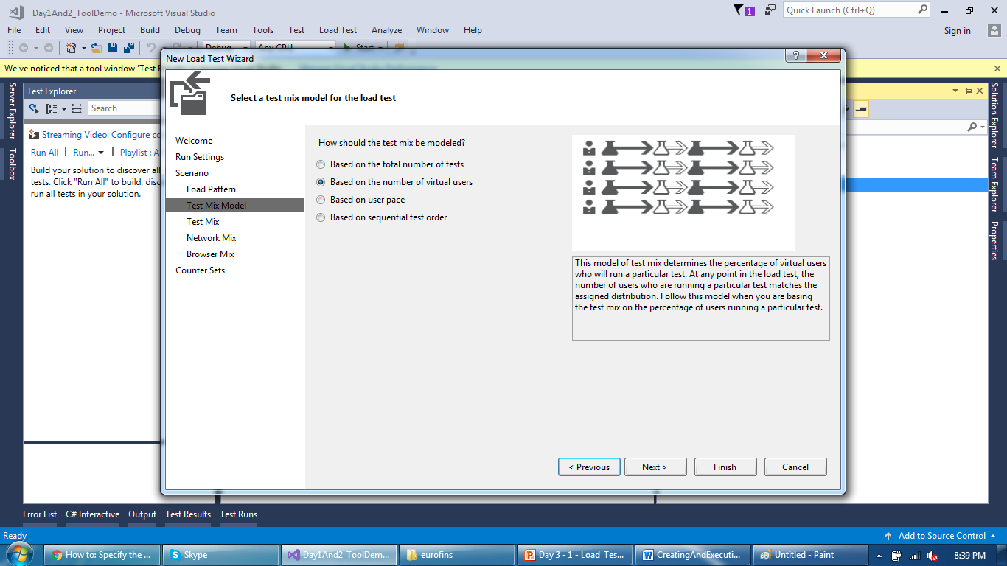
Load Test Execution
Mixed test with known number of users across each script

Slide 14

Load Test Execution
Provide percentage of virtual users across each script

Slide 15
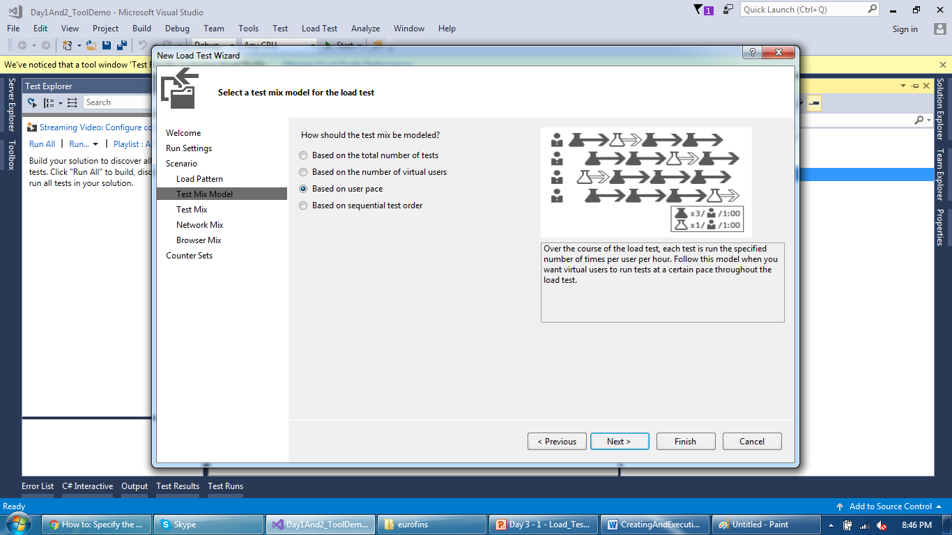
Load Test Execution
Mixed test with number of iterations for every script

Slide 16
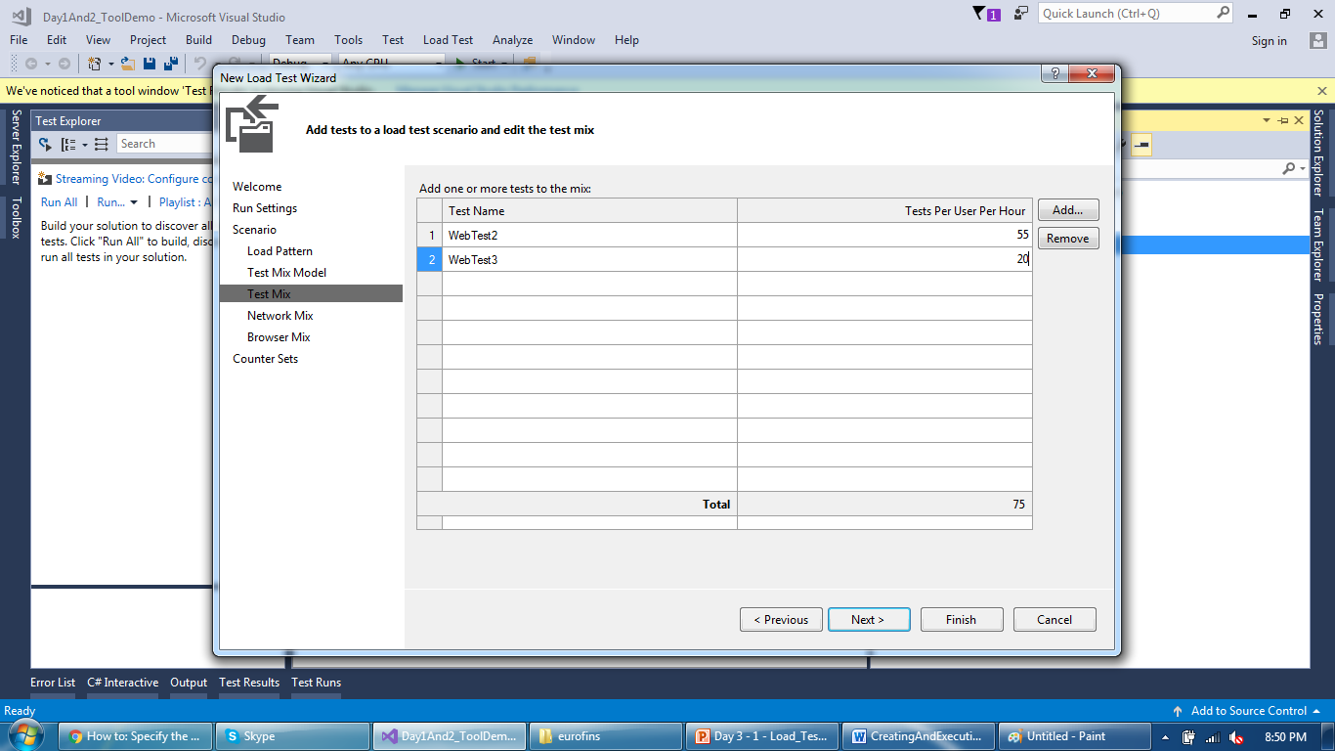
Load Test Execution
Provide number of iterations to complete for every script

Slide 17
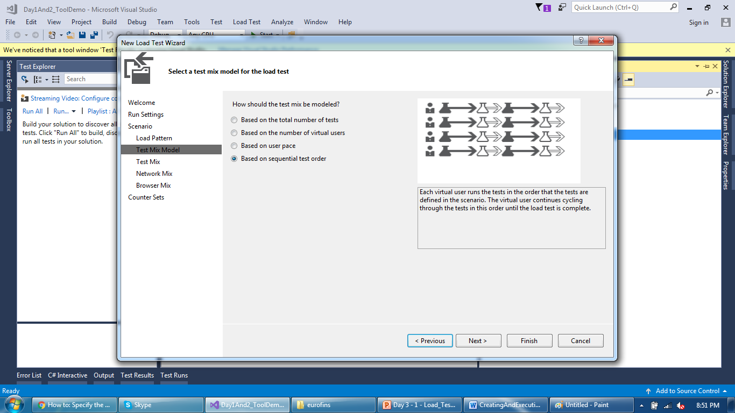
Load Test Execution
Run all scripts for same users but sequentially (one by one)

Slide 18

Load Test Execution
Provide scripts and their order, no distribution needed

Slide 19
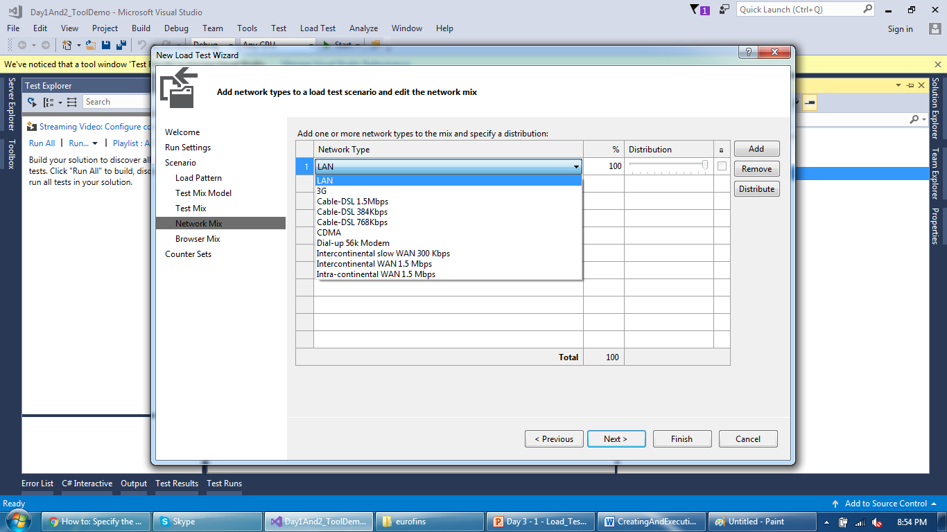
Load Test Execution
Provide network parameters (LAN for NO network restrictions)

Slide 20
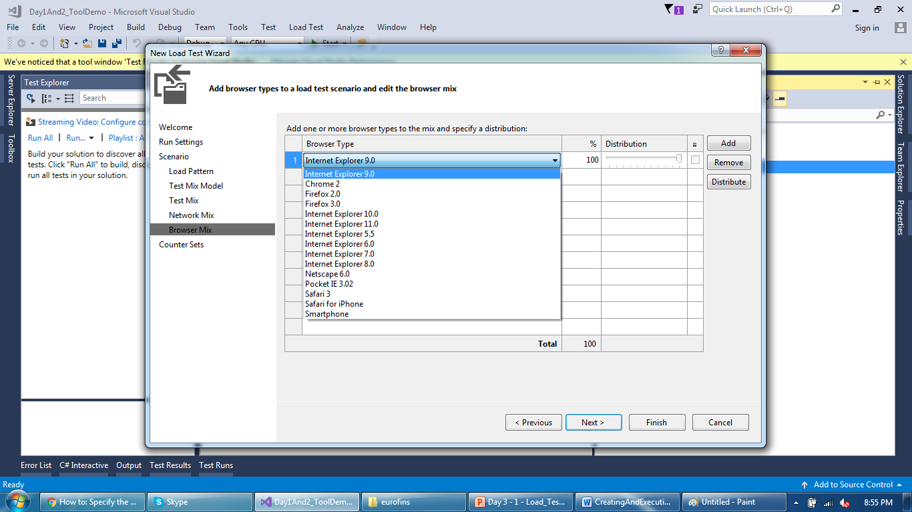
Load Test Execution
Provide browser mix in case need multiple browsers

Slide 21
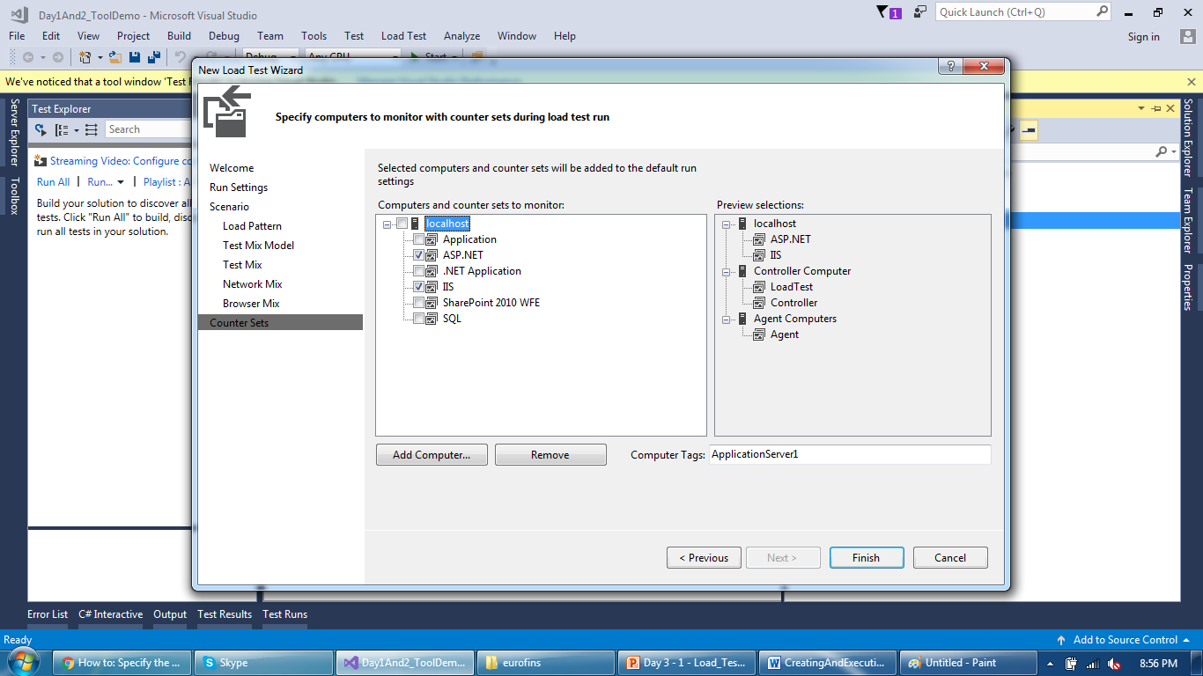
Load Test Execution
Provide monitoring counters to monitor and server name

Slide 22
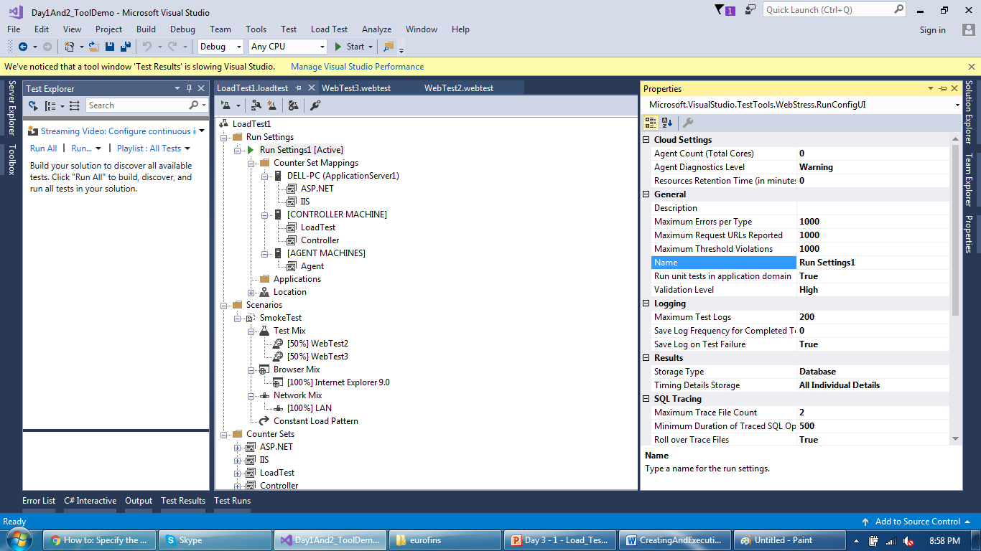
Load Test Execution
Test added to a project and it has properties for all elements

Slide 23
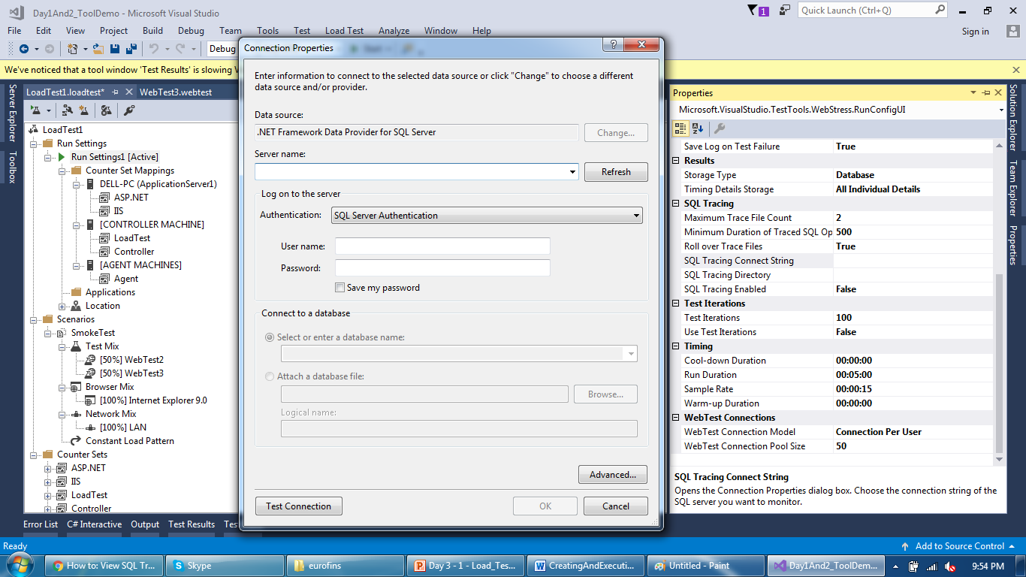
Load Test Execution
Run setting has additional property like SQL tracing

Slide 24
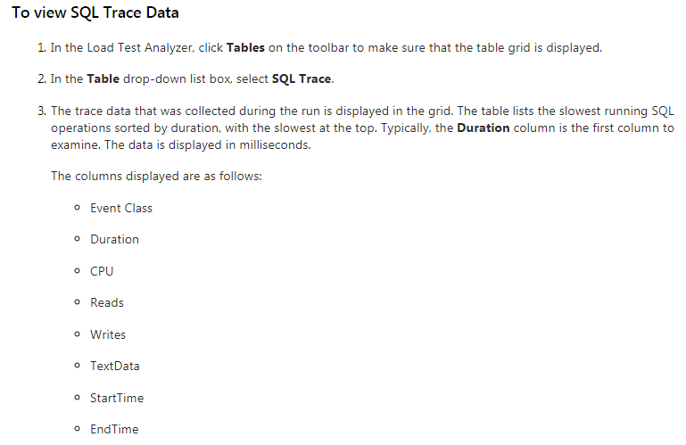
Load Test Execution
Captured SQL trace can be analyzed using Load Test Analyzer

Slide 25
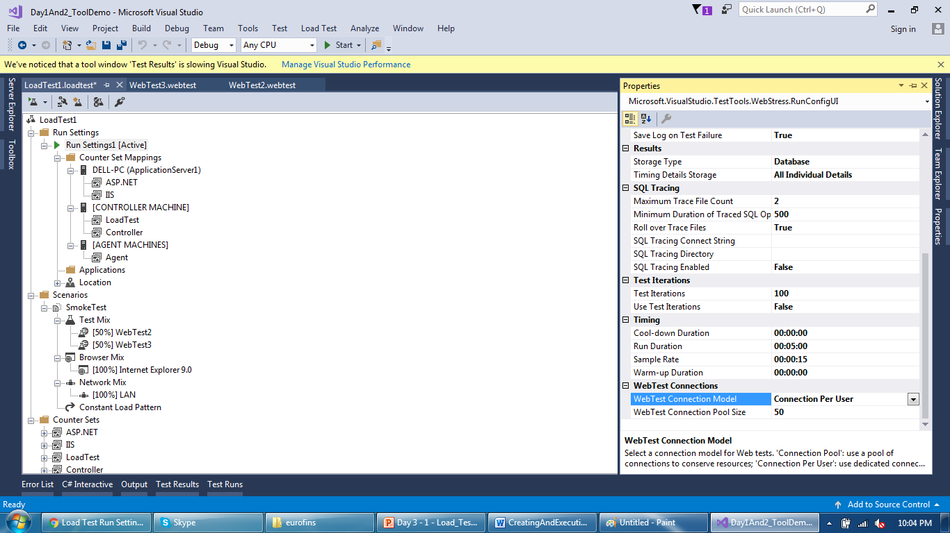
Load Test Execution
WebTest connection allows to manage agent’s utilization

Slide 26
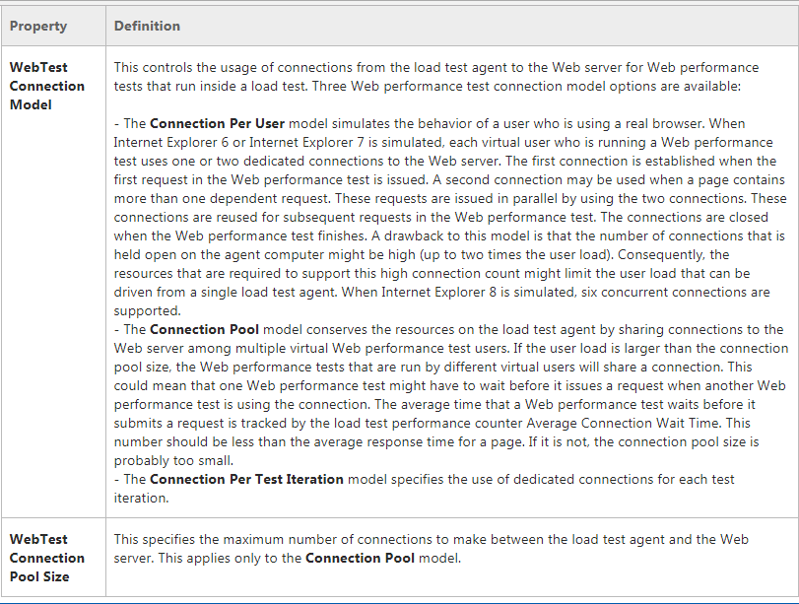
Load Test Execution
Test added to a project and it has properties for all elements

Slide 27
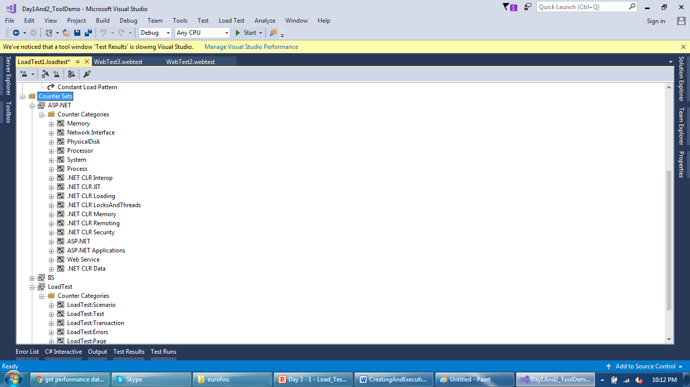
Load Test Execution
Irrelevant counters can be deleted for a test

Slide 28
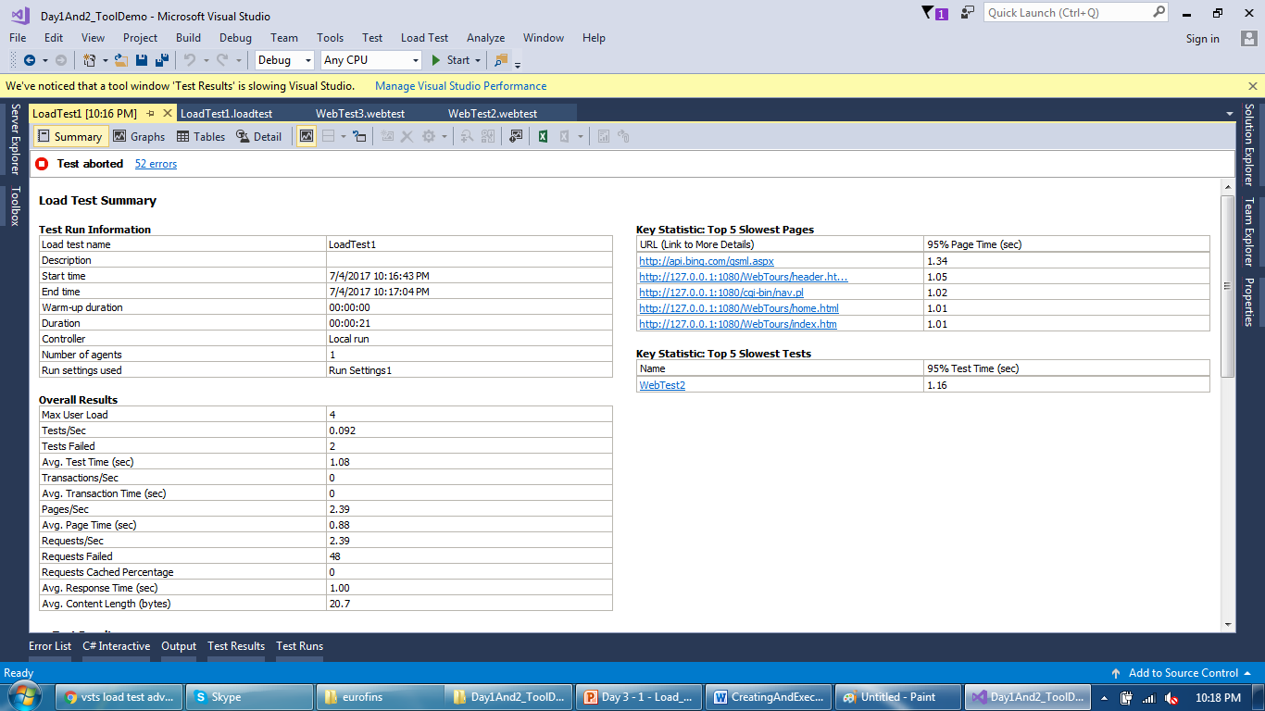
Load Test Execution
After test completion, results looks like this

Slide 29
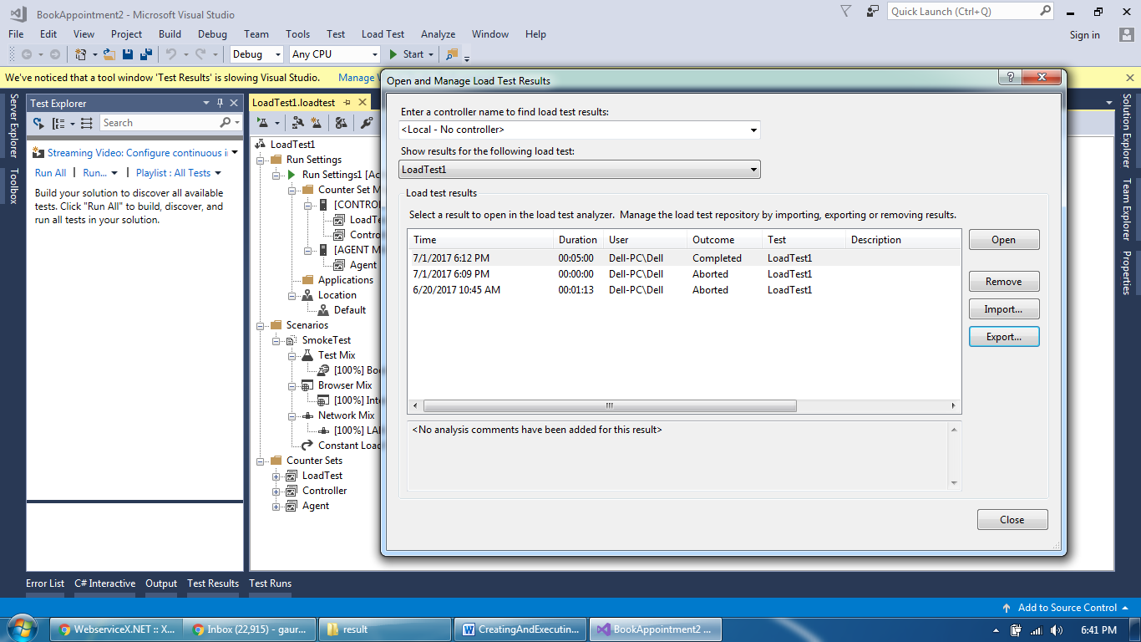
Load Test Execution
Saved test results can be fetched from SQL server table

Slide 30
Load Test Execution
For trial purpose, create a Cloud based account
https://www.visualstudio.com/team-services/cloud-load-testing/
It will create your own Cloud based team services account
https://ankushloadrunner.visualstudio.com/MyFirstProject
Use this as input while creating a Load Test

Slide 31
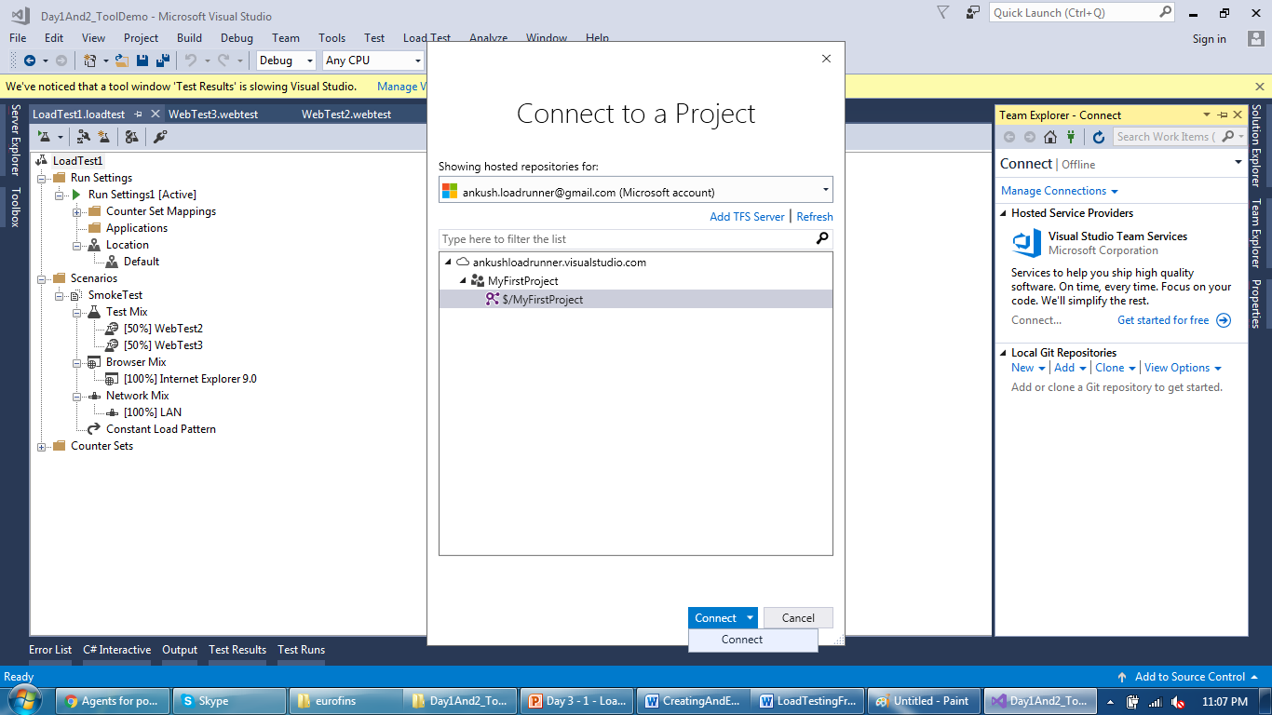
Load Test Execution
Connect to your cloud based account through team services

Slide 32
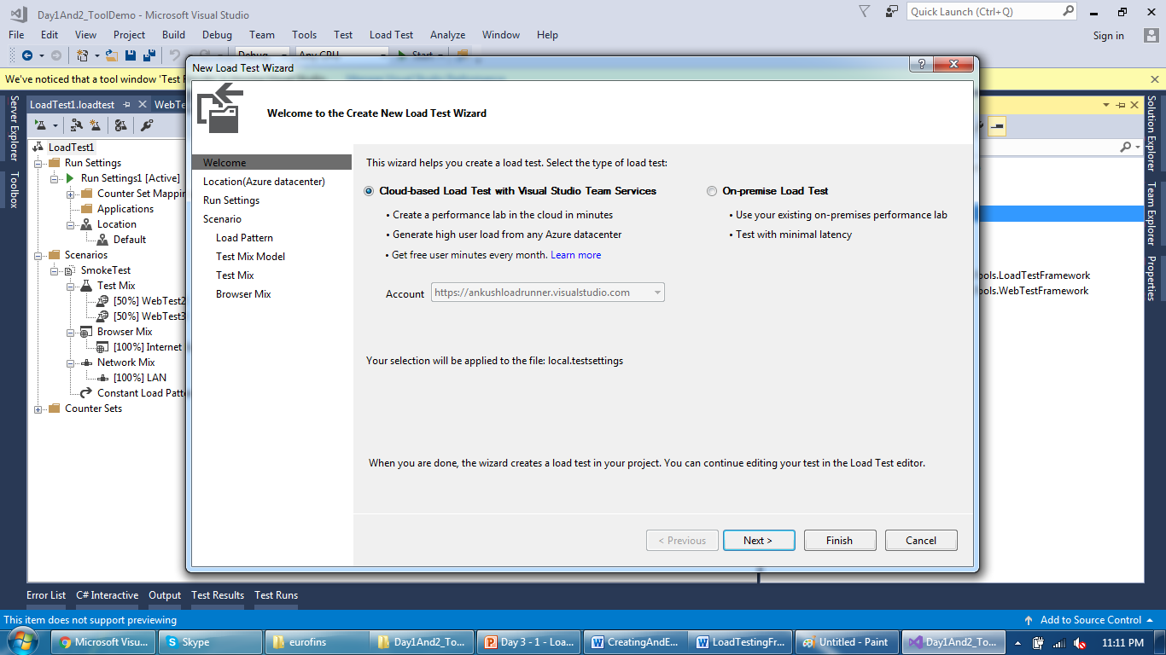
Load Test Execution
Account will be visible while creating new load test

Slide 33
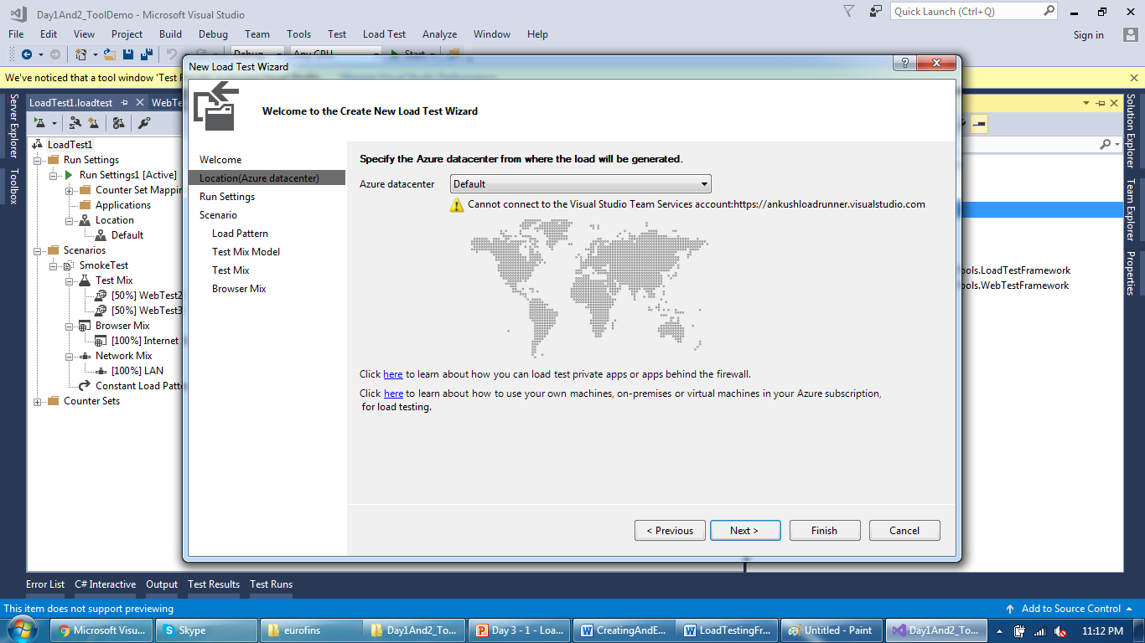
Load Test Execution
Select region of data center from where you want to run test

Slide 34
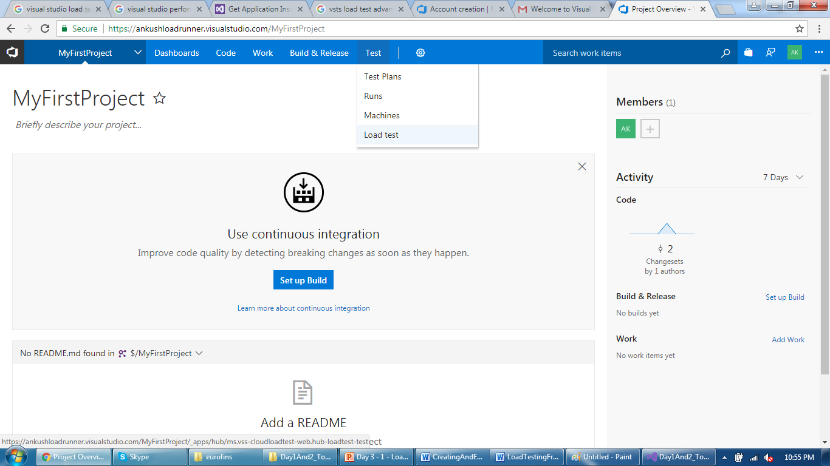
Load Test Execution
Load Test can also be created directly on a Cloud account as well

Slide 35
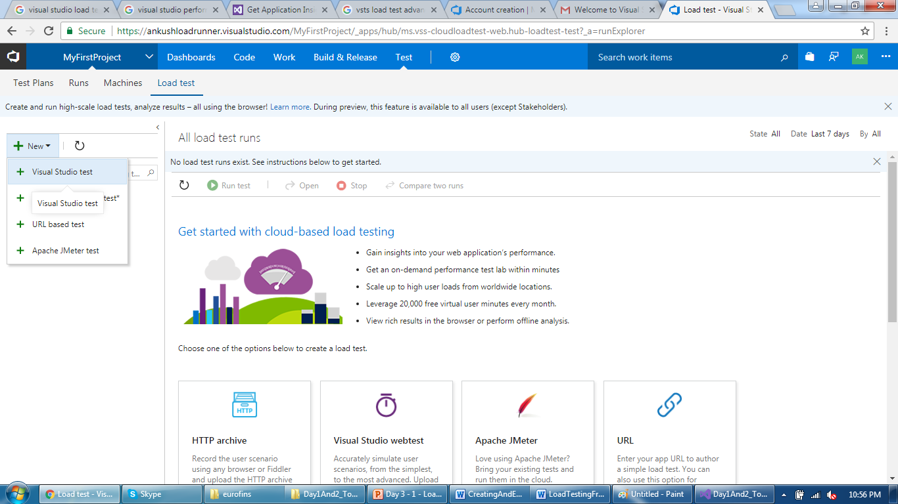
Load Test Execution
Upload a Visual Studio Test on a Cloud

Slide 36
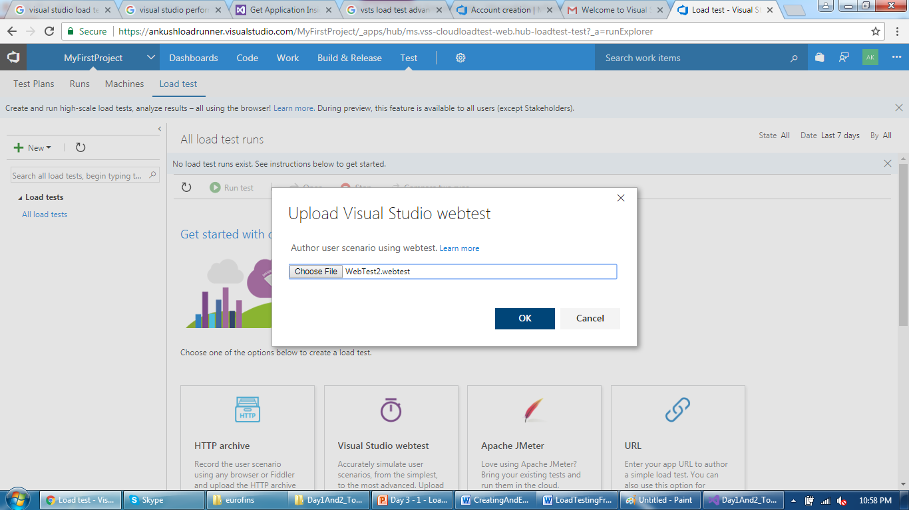
Load Test Execution
Select file and click OK

Slide 37
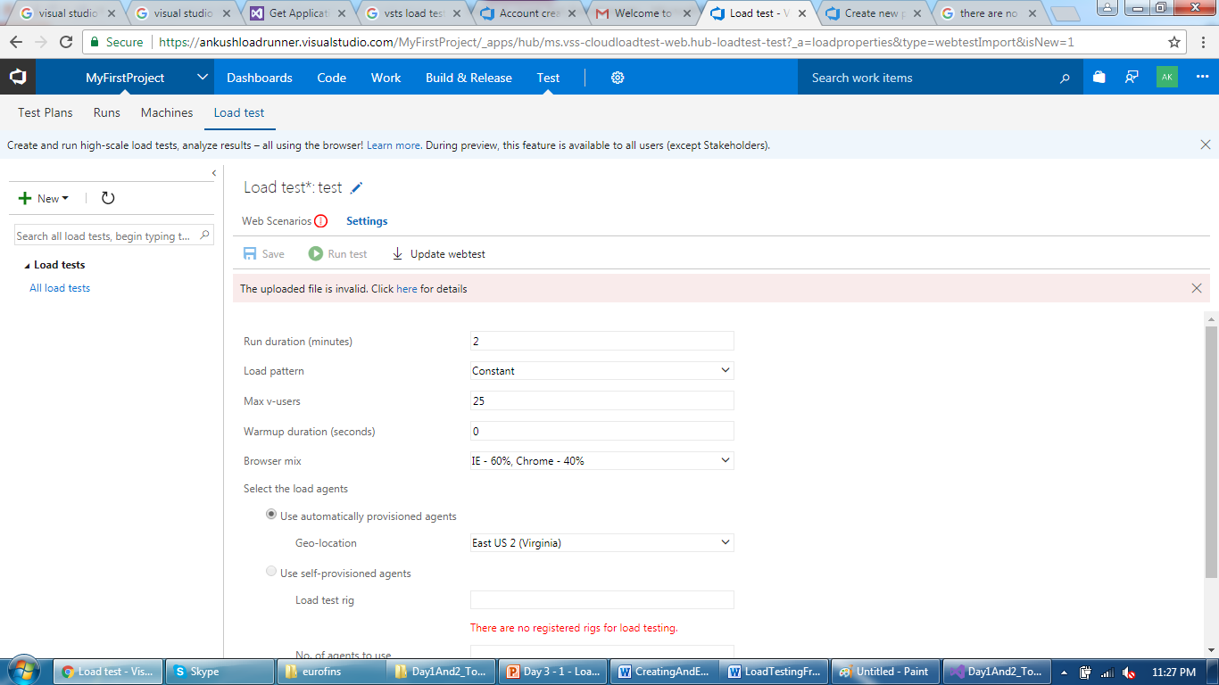
Load Test Execution
Some error while creating a Load Test

Slide 38
Reporting Feature
Report Generation using Excel
https://blogs.msdn.microsoft.com/slumley/2009/05/22/vsts-2010-feature-load-test-excel-report-integration/
https://blogs.msdn.microsoft.com/slumley/2009/11/06/vsts-2010-feature-load-testing-run-comparison-report-in-excel/

Slide 39
Installing and Configuring Agent
Test Agent, SQL server, Controller sizing
https://msdn.microsoft.com/en-us/library/ee390841(v=vs.110).aspx
Adding or removing agent
https://msdn.microsoft.com/en-us/library/dd695837(v=vs.110).aspx
https://msdn.microsoft.com/en-us/library/hh546459.aspx

Slide 40
Thank You

